Slide 1
IBM University Engagement
Project Submission
“Exploring the Power of Agentic AI with IBM Granite and LangFlow”

Slide 2



Project Tile –
CAPSTONE PROJECT
Domain of Project – INDUSTRY
RecentPassport
Mobile number
Student Name
Photo
Email ID
[WhatsApp]
mayankmahure005
@gmail.com
MAYANK
9319050629

Slide 3
OUTLINE
○
○
○
○
○
○
○
○
Problem Statement
Proposed System/Solution
System Development Approach (Technology Used) Algorithm & Deployment
Result (Output Image) Conclusion
Github LINK
Future Scope
Refrences
○

Slide 4
PROBLEM STATEMENT
○
○
Problem statement No.39 – Predictive Maintenanceof Industrial Machinery
Example:
This project aims to predict equipment failures in industrial machines before they happen using sensor data. By analyzing real-time
parameters like temperature, torque, and tool wear, a classification model is built to identify issues like tool wear, overheating, or power failure. This helps enable proactive maintenance, minimizing downtime and operational costs.

Slide 5
PROPOSED SOLUTION
○
Theproposedsystemaimstoaddressthechallengeofpredictingpotentialmachine failures in industrial environments before they occur. This
involves leveraging dataanalyticsandmachinelearningtechniquestoaccuratelyforecastfailurepatternsbasedonoperationaldata.The solution will consist of the following components:
Data Collection:
○
○ ○
Gather historical sensor data from industrial machines, including parameters like temperature, torque, rotational speed, and tool wear. Focus solely on the available sensor readings from the dataset without relying on external contextual inputs.
○
Data Preprocessing:
○ ○
Clean and preprocess the raw sensor data to handle missing values, outliers, and inconsistencies.
Perform feature engineering to derive relevant indicators (e.g., rate of temperature change, wear thresholds) that may signal upcoming failures.
○
Machine Learning Algorithm:
○
IBM watsonx.ai'sAutoAIgenerated a Snap Random Forest Classifier (Batched Tree Ensemble) that achieved a cross-validation accuracy of 99%. This ensemble model aggregates multiple decision trees to classify failure types accurately based on input sensor data.
The model pipeline was automatically enhanced using Feature Engineering (FE) and Hyperparameter Optimization (HPO) to improve
○
accuracy androbustness. Real-time features like air temperature, process temperature, torque, and tool wear were key inputs for
classification.

Slide 6
○
Deployment:
○
IBMWatsonx.aiStudio isusedtodeploythe trained Snap Random Forest Classifier, enabling real-time predictions via an easy-to-use
interface that accepts JSON or CSV inputs.
IBM's hybrid pipeline, which provides quick, scalable, and dependable access to real-time machine failure predictions, powers the
model. It also has a public REST API.
○
○
Evaluation:
○
During AutoAItraining in IBM Watsonx.ai Studio, accuracy metrics and cross-validation were used to evaluate the model's performance.
○
Accuracymetrics and cross-validation were used to evaluate the model's performance during AutoAItraining in IBM Watsonx.ai
Studio.
Result:
○
Thedeployed model accurately predicts failure types such as tool wear, power failure, and overheating, enabling proactive
maintenance

Slide 7
SYSTEM APPROACH
Thissectionoutlinesthe overall strategyandmethodology for developing and implementing the
Predictive Maintenance System using IBM watsonx.ai Studio.Here's a suggested structure for this
section:
○
System requirements Tobuildanddeploythepredictivemaintenance classification model, the
:
following components were required:
• • • • • •
IBM watsonx.ai Studio for AutoAIpipeline generation and deployment. IBM watsonx.ai Runtime for inferencing and model training.
Watson Machine Learning services for deployment and scalability.
Online deployment environment with a REST API endpoint for real-time prediction.
10–20 Capacity Unit-Hours (CUH)
Compute environments (1–4 vCPUs, 4–16 GB RAM)

Slide 8
○
Library required to build the model: Key libraries and tools used in the AutoAIpipeline and backend processing:
•AutoAI–Automated data preprocessing, feature engineering, and model
selection
Snap Random Forest Classifier –Chosen as the top-performing algorithm
•
• •
Pandas & NumPy –For initial dataset formatting
Sklearnmetrics(internallyused)–Formodelevaluation (accuracy,
precision, recall, F1)
•
DeploymentSpaceonwatsonx.ai–Forreal-timeonline predictions via
JSON input
•
APIreference&testinginterface–ProvidedbyIBM watsonx.ai for
integration

Slide 9
ALGORITHM & DEPLOYMENT
○
The SnapRandomForest Classifier,chosen byIBM watsonx.ai'sAutoAIfor itshigh accuracy, it was deployed to deliver real-
time failure predictions in the maintenance system. Its robust performance made it ideal for production use. Algorithm Selection:
○
○
ThemodelchosenbyIBMwatsonx.ai’sAutoAIwastheSnapRandomForestClassifier,whichemergedasthebest-
performing algorithm during experimentation.
This ensemble-based tree classifier is well-suited for handling tabular sensor data and performs well in classifying different failure types. Its ability to manage non-linear relationships and categorical variables makes it ideal for predictive maintenance tasks.
○
○
Data Input:
○
The model uses key sensor inputs—machine type, air and process temperatures, rotational speed, torque, and tool wear—to assess equipment health and predict failures.
These features reflect the machine’s operational state and help the model detect early signs of issues before they escalate.
○

Slide 10
○
Training Process:
○
Training was done via IBM watsonx.ai AutoAI, which automatically handled feature engineering, cross-validation, and hyperparameter tuning.
○
It generated multiple pipelines, with the best one (Snap Random Forest) achieving ~99.5% accuracy.
○
Prediction Process:
○
It accepts input as a structured JSON or CSV format through the online deployment interface in watsonx.ai.
○ ○
The model then returns the predicted failure type, enabling preventive action before actual breakdowns occur. Once deployed, the trained Snap Random Forest model classifies real-time operational data into potential failure categories.

Slide 11
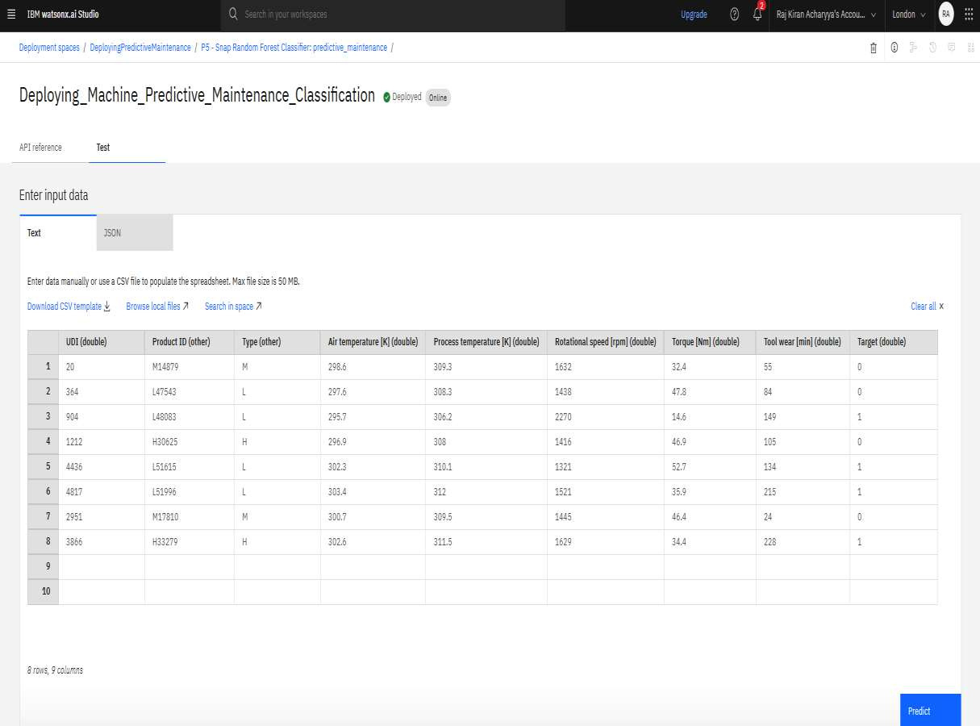

RESULT

Slide 12
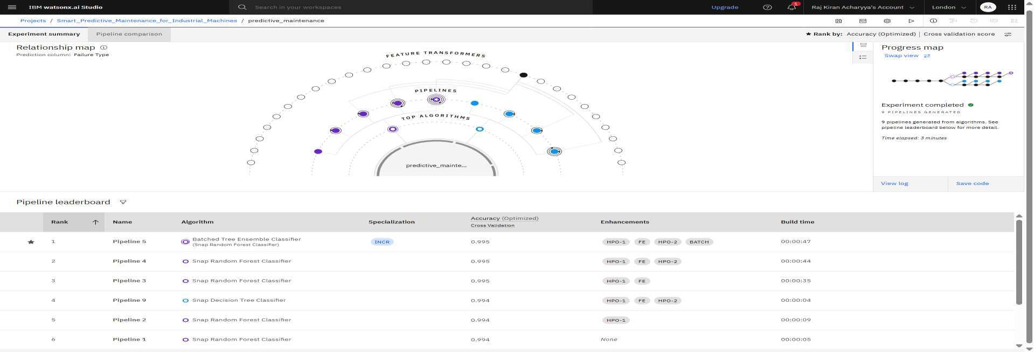

Slide 13
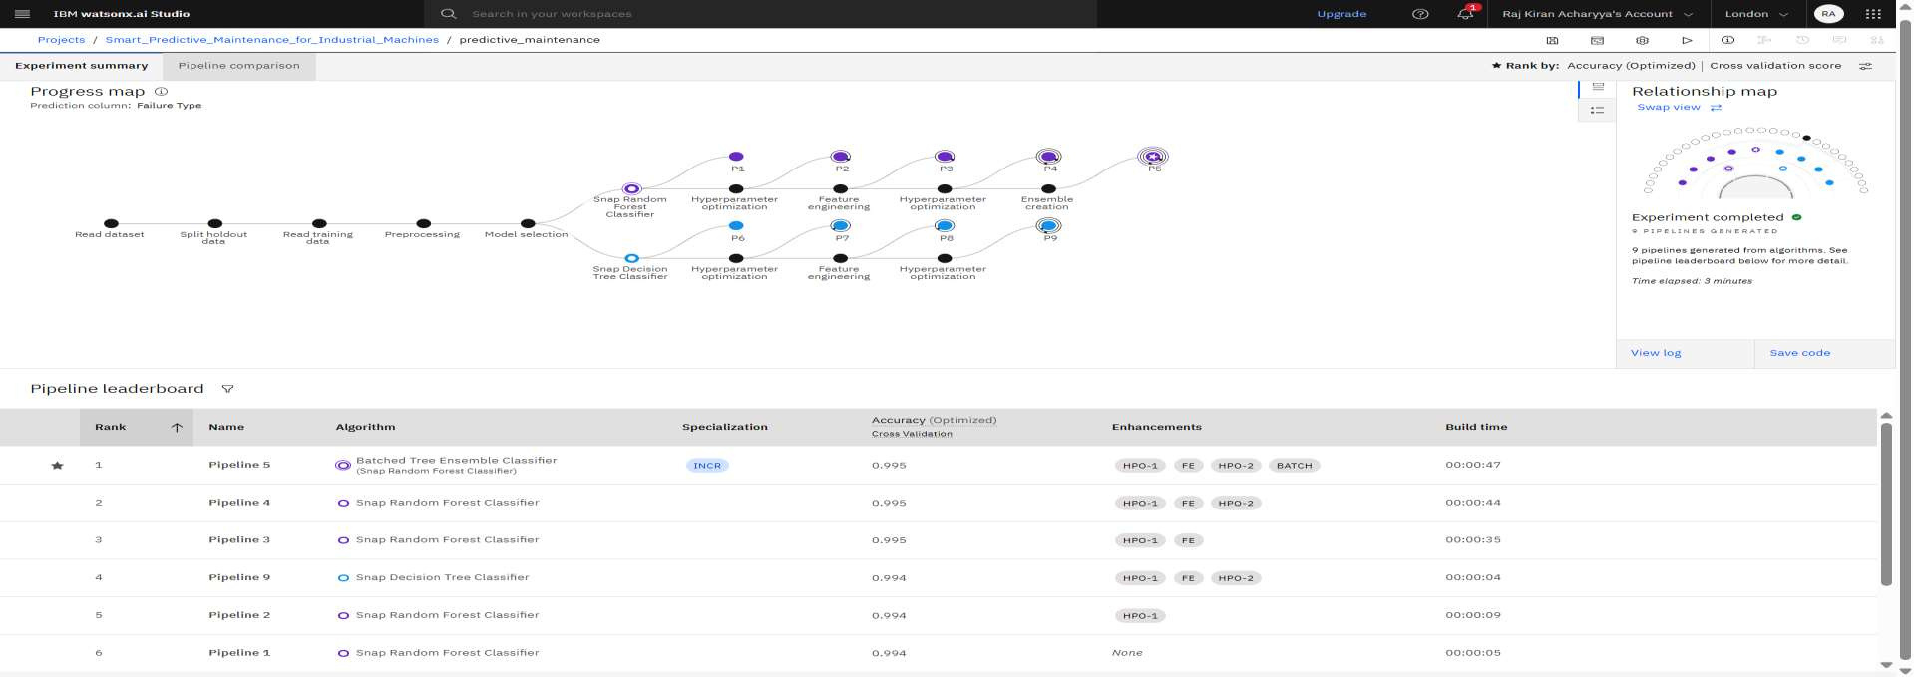

Slide 14
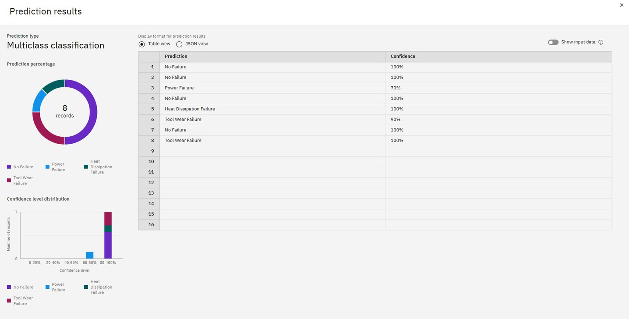

Slide 15
CONCLUSION
○
In this project, I developed a predictive maintenance model for industrial machinery using IBM watsonx.ai Studio and AutoAI. By working with real-time sensor data and applying the Snap Random Forest Classifier, I was able to accurately classify failure types such as tool wear, overheating, and power failure. The model showed strong predictive performance, making it suitable for proactive maintenance that can reduce downtime and operational costs.
○
Through thiswork, I’ve seen firsthand howAIcan playapowerfulroleinimprovingmachine
reliability and efficiency. This project helped me understand the value of predictive analytics in industrial settings and how intelligent systemscan supportsmarterdecision-making.

Slide 16
Git Hub Link
  https://github.com/Be-mayank/AICTE-IBM-INTERNSHIP.git
·
·

Slide 17
FUTURE SCOPE
•
Integration with IoT Platforms:Real-time sensor data can be streamed using IoT devices to enhance live monitoring
and quicker failure detection.
•
Model Enhancement with Deep Learning: Future versions can use LSTM or CNN models for improved accuracy,
especially on sequential or time-series data.
•
Expansion to Other Industries: The model can be adapted for predictive maintenance in sectors like aviation,
automotive, and manufacturing.
•
AutomatedAlertSystem:Integrationof the modelwith maintenance scheduling systemscantrigger alerts and
maintenance tickets automatically.
•
Edge Computing Deployment: For faster, on-site processing without relying on cloud latency, models can be
deployed on edge devices.
•
Continuous Learning Loop: With more data, the model can be retrained periodically to improve performance and
adapt to new failure patterns.
•
Incorporating Cost Analysis: Adding a cost-benefit layer to prioritize maintenance actions based on economic
impact.

Slide 18
REFERENCES
○
Kaggle dataset link –https://www.kaggle.com/datasets/shivamb/machine-predictive-
IBM Cloud Documentation--
maintenance-classification
○
h t t ps://www.ib m.com/cloud/watsonx-ai

Slide 19
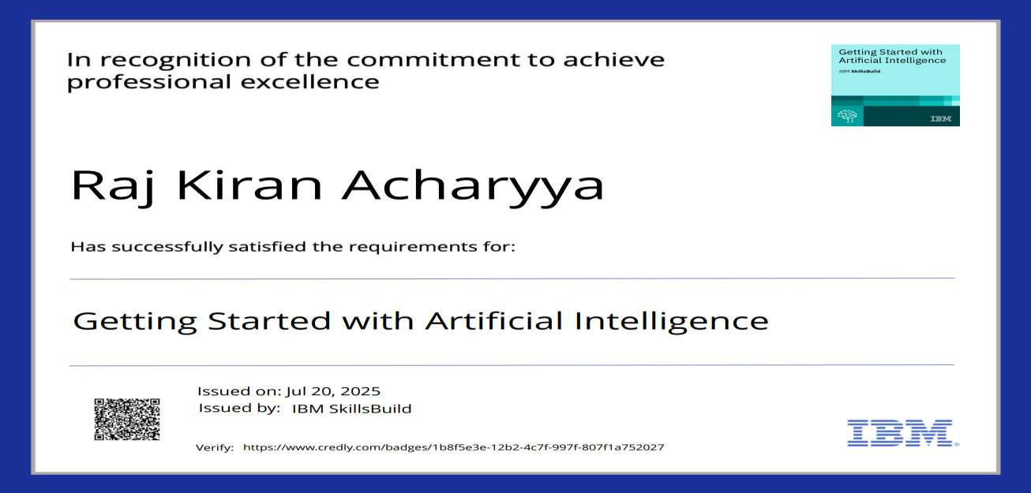
IBM CERTIFICATIONS
MAYANK
○
Screenshot/ credlycertificate( getting started with AI)
Oct 23, 2026

Slide 20
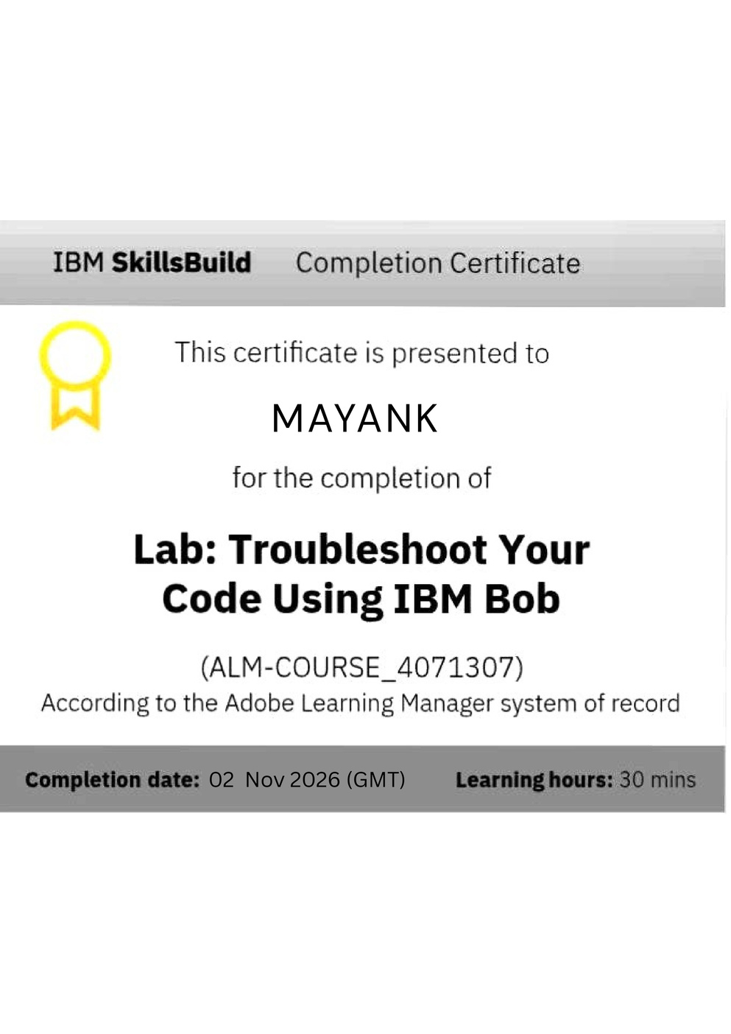
IBM CERTIFICATIONS

Slide 21


